Slide 1
WVBU
I‘m sideways!

Slide 2
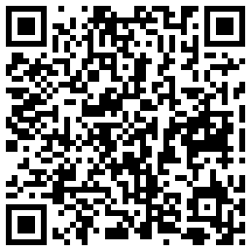
EXAM TIME

Slide 3
I‘m more sideways!
This is making me dizzy
Please stop
Review of what we just did

Slide 4
SHOWPICKS
Wheeeee!

Slide 5

Bucknell Today!
Time to pick weekends

Slide 6
GO FORTH
AND CLAIM THE AIRWAVES

